Slide 1
Ocular Disease Classification Using Image Recognition
Group 3: Mica Haney, Neda Langroodi, Bijesh Patel Vachanni

Slide 2
Agenda
Topic Background
Project Goal
Data
Methodology
Model #1
Model #2
Best Model
Next Steps
References

Slide 3

Intro

Slide 4
Topic Background
Diseases affecting the eye are identified by sight, specifically how the eye looks.
Often pictures are taken of the inside of an eye to study a malady more closely and also cause less discomfort to the patient.
There are many systems in development meant to use such pictures to help doctors make faster, more accurate diagnoses.
The diseases that our system identifies each affect millions of Americans a year individually, combined the numbers are in the tens of millions.

Slide 5

Goal
Create an Ocular Disease Prediction System based on digital image processing that can aid opthamologists and medical professionals in patient diagnoses
Use Python and tensorflow module to train a convolutional neural network to classify different types of ocular diseases

Slide 6
Data

Slide 7
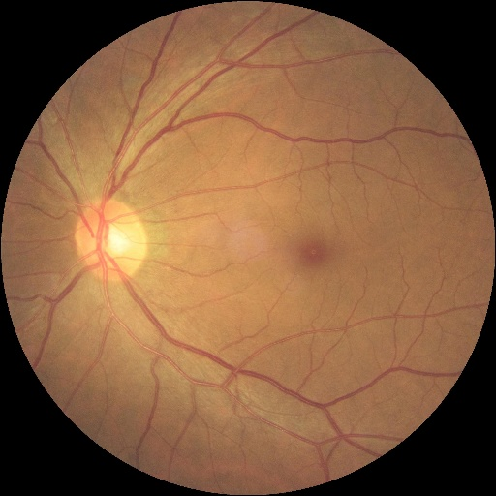
Images
The dataset retrieved from Kaggle contained 14392 images in total, with 7000 training images, 1000 testing images, and 6392 preprocessed training images.
We only worked with the preprocessed images due to time constraints. They were split into training, validation, and testing datasets in a ratio of 80 : 20 which translates to counts of 5111 : 1281.

Slide 8
CSV Data
Category | Count | Percentage
Normal (N) | 2873 | 44.95%
Diabetes (D) | 1608 | 25.16%
Other Diseases/Abnormalities (O) | 708 | 11.08%
Cataract (C) | 293 | 4.58%
Glaucoma (G) | 284 | 4.44 %
Age Related Macular Degeneration (A) | 266 | 4.16%
Pathological Myopia (M) | 232 | 3.63%
Hypertension (H) | 128 | 2.00%
The images also came with “metadata”, including things like patient age and sex, as well as the diseases the other eye of a patient has. The only information taken from this was the target labels, a one-hot-encoded list indicating which disease an eye has. The categories of diseases and their counts and percentage of the dataset are listed on the right.

Slide 9
Methodology: Model Designs and Results

Slide 10
Model Design #1
Train/test split of 80/20 and classes limited to normal, cataracts, and myopia
Images read in using cv2 module and resized from 512x512 to 128x128
Images were brightened by a scale of 0.4
Imbalanced class treatment: limited “Normal” images to 300 since “Cataract” and “Myopia” hold 232-293 images
Tensorflow keras used to build and train CNN from scratch
Batch size = 10; LR = 1e-5; Loss = sparse categorical cross entropy; Adam optimizer; number of epochs = 30

Slide 11
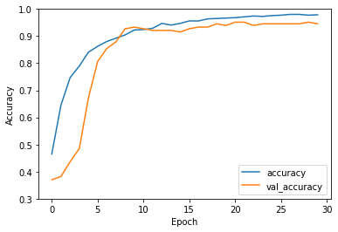
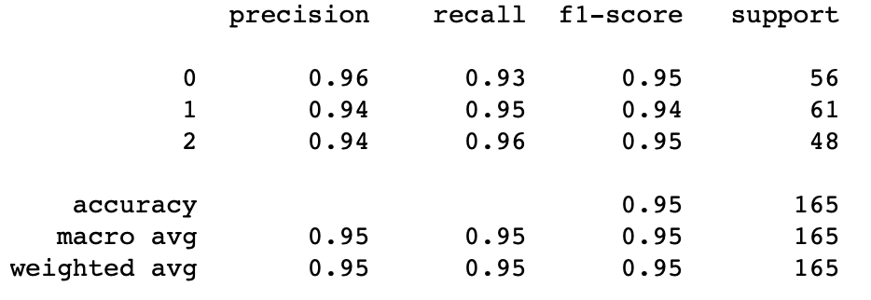
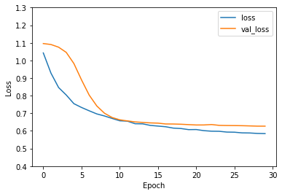
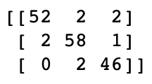
Model Results #1
Confusion Matrix and Classification Report (Classes: 0=Normal, 1=Cataract, 2=Myopia)

Slide 12
Model Design #2
Pre-Trained model VGG19 CNN - 19 layers.
Train/test split of 80/20 and classes limited to normal and cataracts.
Input image size of the network was resized to 224x224.
Adam Optimizer to train the Convolutional Neural Network.
Batch size - 32, Loss=binary cross entropy.
Modelcheckpoint to save keras model or model weights at some frequency.
Function used for training model - ModelCheckpoint, ReduceLROnPlateau, PlotLossesKerasTF, fit.

Slide 13
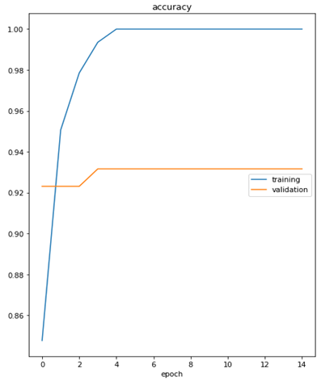
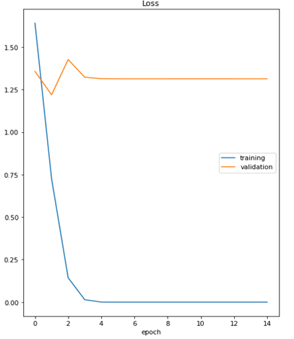
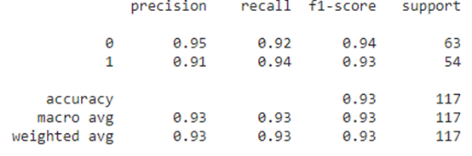

Model Results #2
Confusion Matrix and Classification Report (Classes: 0=Normal, 1=Cataract)

Slide 14
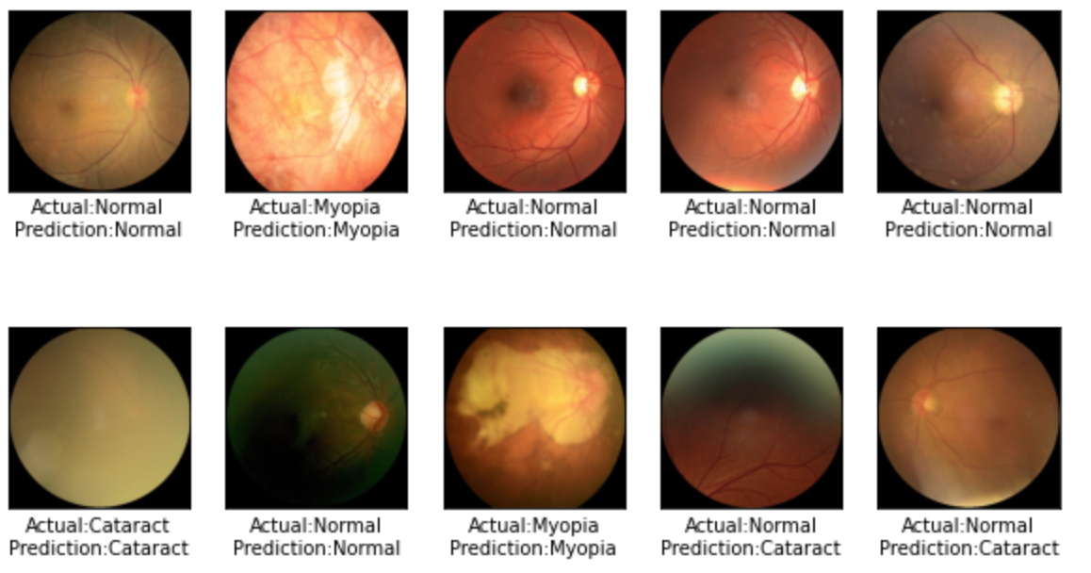
Best Model
Model Design #1
Normal, Cataract, and Pathological Myopia classes
94.55% accuracy
0.6269 loss

Slide 15
Next Steps
Continue tweaking model architecture until 98-99% accuracy is achieved and model can diagnose and as many classes as possible
Create a web application that medical professionals can utilize to help diagnose patients
Users can access a web application, upload their target images, and receive a reliable disease prediction
Eventually, model can be developed along with imaging equipment to give on-demand disease prediction seconds after the medical imaging takes place

Slide 16
References
https://www.kaggle.com/andrewmvd/ocular-disease-recognition-odir5k
https://towardsdatascience.com/ocular-disease-recognition-using-convolutional-neural-networks-c04d63a7a2da
https://www.kaggle.com/gpreda/cataract-prediction-using-transfer-learning
https://www.researchgate.net/profile/Sreelatha-Selvaraj/publication/325659102_Application_of_Digital_Image_Processing_in_Healthcare_Analysis_based_on_Hand_Image/links/5b1bb3b345851587f29e2d3f/Application-of-Digital-Image-Processing-in-Healthcare-Analysis-based-on-Hand-Image.pdf
https://www.nvisioncenters.com/education/eye-disease-statistics/#:~:text=About%2037%20million%20Americans%20use,the%20use%20of%20contact%20lenses.

Slide 17
Thank you!

